Slide 1

Bike Rental Data Analysis Presentation
End-to-End Excel Project: Transforming Raw Data into Actionable
Business Insights
Presenter
Avik Dhar Chowdhury

Slide 2




Project Scope
Comprehensive Project Overview
Identify specific rental demand patterns based on temporal factors, weather etc.
Defining the core objectives and technical stack used for this data-driven analysis.
Develop a complete automated workflow starting from raw datasets to a final dataset
Leverage Microsoft Excel as the primary engine for data engineering
Utilize Power Query, Pivot Tables, and dynamic charts to create a scalable data.

Slide 3
Data Inventory
Primary Dataset Characteristics
Mapping the key variables and data structures used in the analysis.
01
Integration of three distinct datasets containing granular hourly and daily rental information.
02
03
04
Environmental variables include Temperature, Humidity, and Windspeed for weather-impact analysis.
User segmentation tracking for Casual Users versus Registered Users to determine loyalty trends.
Final output metric defined as the Total Count of bike rentals across all specified timeframes.

Slide 4





The Data Cleaning Pipeline
Ensuring data integrity through rigorous cleaning and standardization steps.
Deduplication
Standardization
Structural Integrity
Scrubbed the datasets to remove redundant entries and ensure unique primary keys.
Applied the ROUND function to normalize decimal values for uniform reporting.
Renamed columns for readability and verified consistency across merged datasets.
Missing Values
Formatting
Utilized the AVERAGE function to impute missing numerical data points logically.
Resolved inconsistencies in date and time formats to enable chronological sorting.

Slide 5




ETL Workflow via Power Query
Merging disparate data sources into a single, unified source of truth.
Transformation
Final Validation
Expanded the nested merged tables to create a flat, structured data hierarchy.
Conducted a final check to ensure the merged data was clean and ready for analysis.
Initial Join
Append Data
Used Power Query to merge Dataset 1 and Dataset 2 based on unique common fields.
Integrated Dataset 3 via the Append function to finalize the comprehensive record set.

Slide 6
Methodology
Advanced Analytical Framework
Methodologies and tools employed to extract patterns and correlations.
01
Summarized high-volume data using Pivot Tables for multi-dimensional analysis.
02
03
04
05
Visualized trends through dynamic Bar, Pie, and Line charts for intuitive reporting.
Identified statistical relationships between variables using Correlation Analysis.
Analyzed data dispersion and consistency through Standard Deviation metrics.
Defined and tracked KPI Metrics to monitor business performance at a glance.

Slide 7
User Analysis
Variability & User Segmentation
Analyzing the consistency and contribution of different user types.
Registered
Casual
Registered users dominate overall rental patterns and show significantly more stable usage cycles.
Casual users show higher standard deviation, indicating their demand is more unpredictable.

Slide 8
Correlation
Weather Correlation Matrix
Quantifying the impact of meteorological factors on rental volume.
Variables | Correlation Type | Impact Level
Temperature | Positive | High
Assumed Temperature | Positive | High
Humidity | Negative | Moderate
Windspeed | Negligible | Low

Slide 9



Environmental Impact
Meteorological Influence Insights
Key takeaways from weather-based rental behavior analysis.
Temperature Sensitivity
Humidity Thresholds
Casual User Vulnerability
Both actual and 'feels-like' temperatures show strong positive impacts on demand, peaking in comfortable ranges.
A notable negative correlation exists; higher humidity levels directly lead to a reduction in active rentals.
Casual users are far more sensitive to weather changes compared to registered users, who rent regardless of conditions.

Slide 10
Hourly Trends
Identifying Peak Usage Hours
Hourly demand distribution revealing peak commuting and leisure times.

Slide 11
Weather Analysis
Weather-Based Usage Breakdown
Comparative analysis of demand across different weather conditions.

Slide 12
Weekly Analysis
Weekly Demand Distribution
Analyzing fluctuations in rental volume across the days of the week.

Slide 13
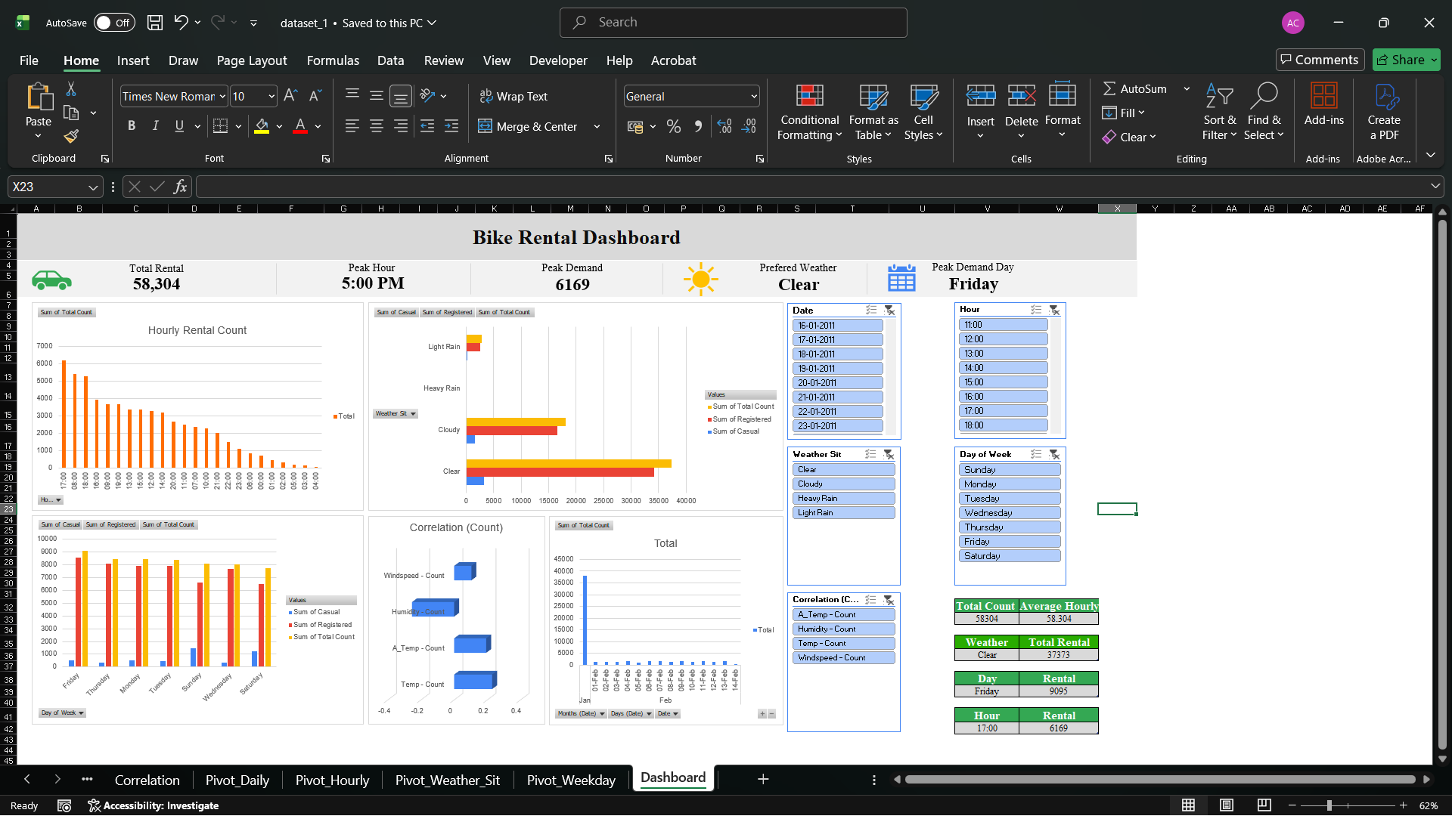
Final Dashboard
Interactive Dashboard KPIs
Key Performance Indicators summarized from the final Excel dashboard.
58,304
6,169
Total Rentals
Peak Hour Demand
Total aggregated rentals across all datasets following cleaning and merging.
Highest single-hour volume recorded at 5:00 PM during the study period.
Clear
Friday
Preferred Weather
Peak Day
The weather condition that consistently generates the highest rental volume.
The day of the week with the maximum recorded activity level.

Slide 14
Conclusion
Project Synthesis & Conclusion
This project demonstrates an end-to-end data analysis workflow using Excel, from raw data to an interactive dashboard. Data was cleaned, transformed, and merged using Power Query to ensure accuracy and consistency. The analysis shows that bike rental demand is strongly influenced by time and weather conditions. Peak usage occurs during evening hours, especially around 5:00 PM, while early mornings have the lowest demand. Clear weather significantly increases rentals, whereas rain reduces user activity. Registered users show more consistent behavior compared to casual users. Overall, the project highlights how data analysis can drive meaningful insights and support better decision-making.

